Slide 1

Haptic Interface in a networked virtual environment
Pirmin, Pepijn, Derk & Chevan

Slide 2
Inleiding
Vorige sprint
Resultaten
Retrospective
Volgende sprint

Slide 3
Vorige sprint
9. Multiplayer Feature Implementation
14. Users get haptic feedback
19. Client communication via microphone

Slide 4
9. Multiplayer Feature Implementation
Tasks:
Develop and integrate multiplayer features in the VR application
Validate synchronization of actions
Acceptence criteria:
Two clients using two VR headsets can connect to the same environment and see each other

Slide 5
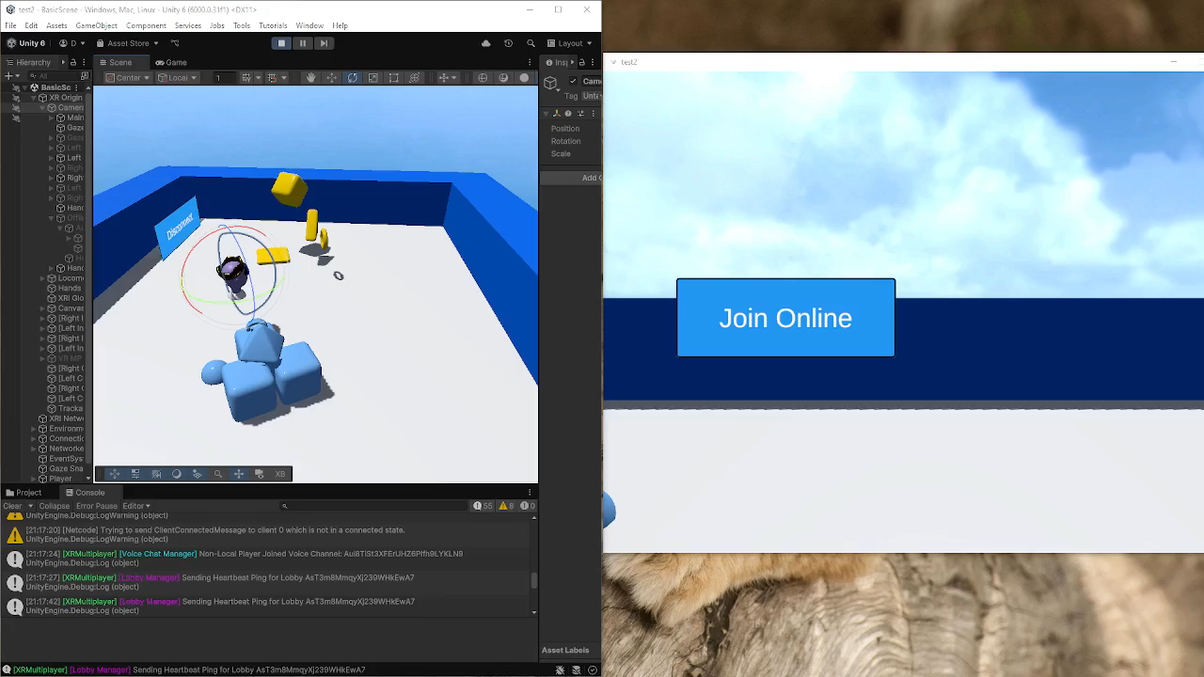
9. multiplayer feature implementation

Slide 6
14. Users get haptic feedback
Tasks:
✔ Implement the haptic device in Unity [Done]
✔ Decide what the haptic feedback will be [Done]
Implement the actual haptic feedback [In progress]
Acceptance criteria:
The user can feel the difference between the height of different buildings or terrain

Slide 7
Retrospective
Teams doet af en toe raar met berichten, dus overgestapt naar WhatsApp

Slide 8
Volgende Sprint
9. Multiplayer Feature Implementation
14. Users get haptic feedback
20. Haptic & VR user experience

